Slide 1
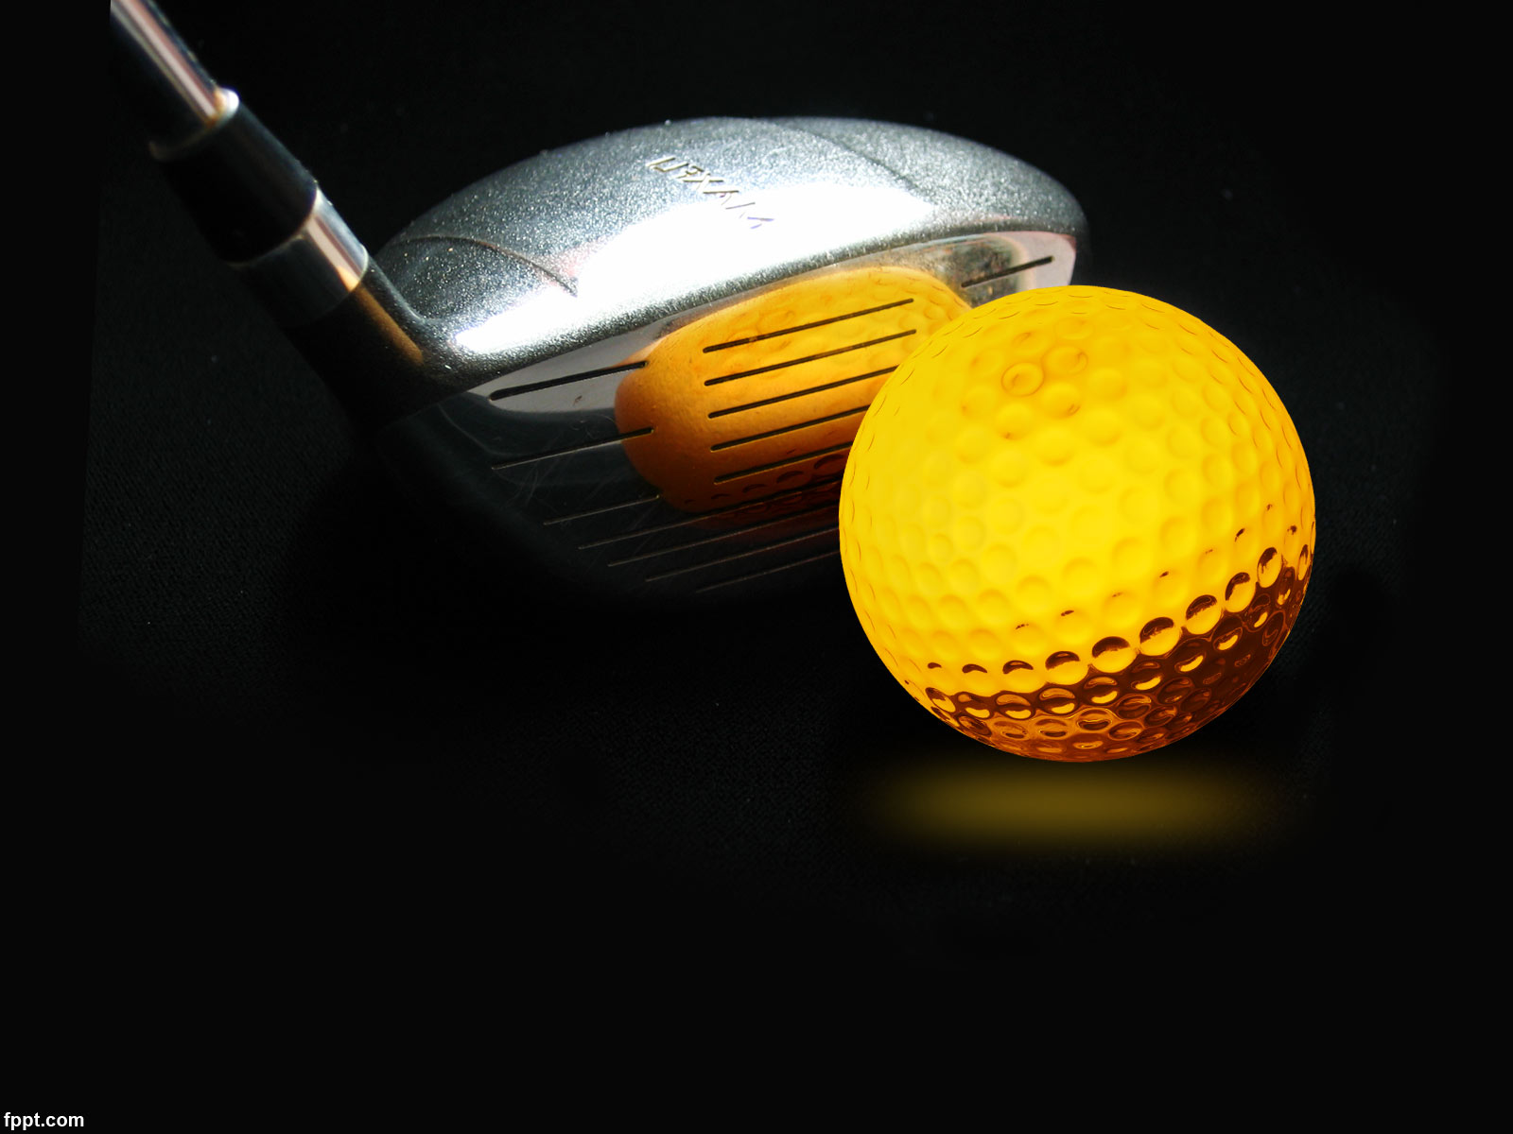
SABADO 19 DE AGOSTO TORNEO HOYO 19 PAREJAS GREENSOME- DOBLE PAR/HANDICAP
PREMIO A LAS DOS PRIMERAS PAREJAS CLASIFICADAS Y BOLA MAS CERCANA EN PARES 3
Aperitivo durante el recorrido
En la entrega de premios: Cóctel/merienda

Slide 2
Slide Title
Make Effective Presentations
Using Awesome Backgrounds
Engage your Audience
Capture Audience Attention

Slide 3
Slide Title
Make Effective Presentations
Using Awesome Backgrounds
Engage your Audience
Capture Audience Attention

Slide 4
Slide Title
Product A
Product B
Feature 1
Feature 2
Feature 3
Feature 1
Feature 2
Feature 3

